Slide 1
MICROSOFT A.I
Agent
Applications
Services
Infrastructure
Cortana
Office 365
Dynamics 365
SwiftKey
Pix
Customer Service and Support
Bot Framework
Cognitive Services
Cortana Intelligence
Cognitive Toolkit
Azure – CPU/GPU at scale
Azure Machine Learning
Notes:
High level view of portfolio. We have Cortana (for consumers), Cognitive Services and Bot Framework (for developers), and Machine Learning (for businesses).

Slide 2
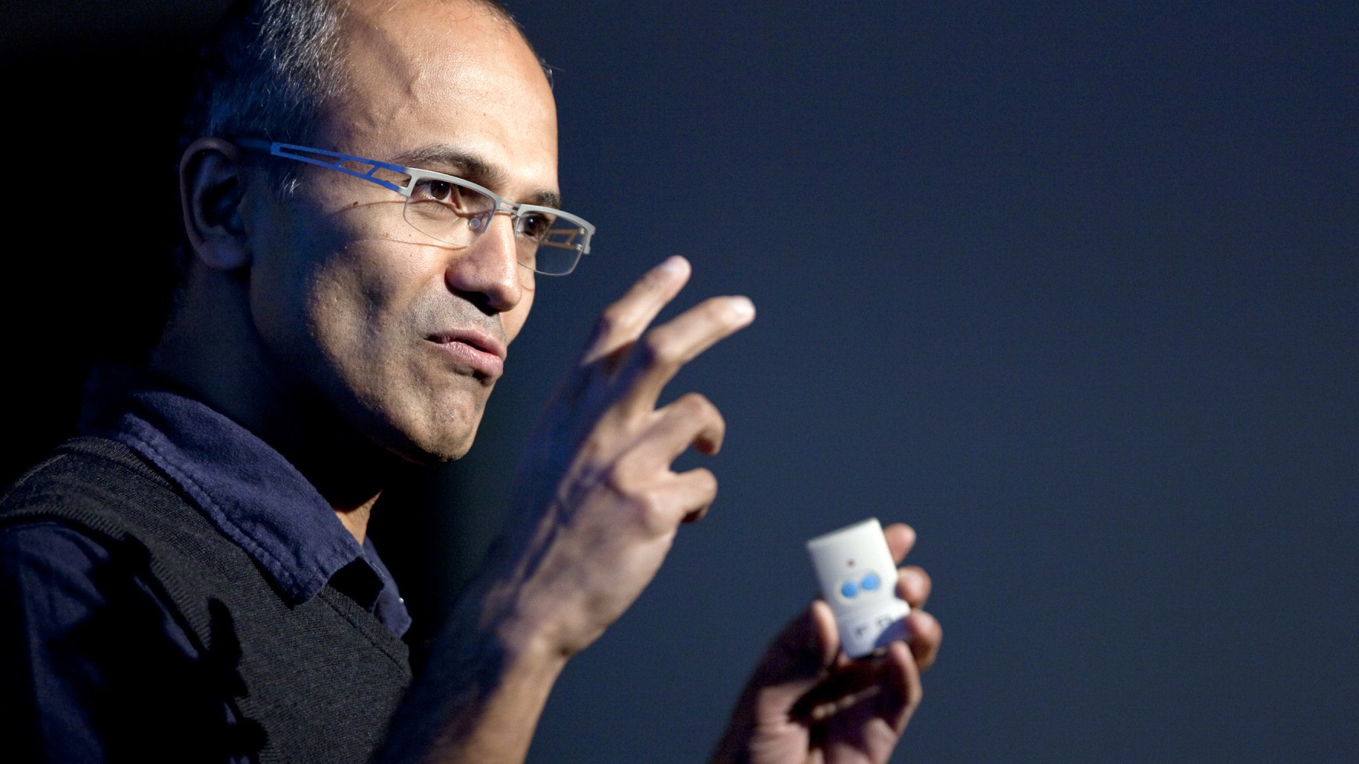
“OUR GOAL IS TO DEMOCRATISE A.I.
TO EMPOWER EVERY PERSON
AND EVERY ORGANISATION
TO ACHIEVE MORE”
SATYA NADELLA

Slide 3
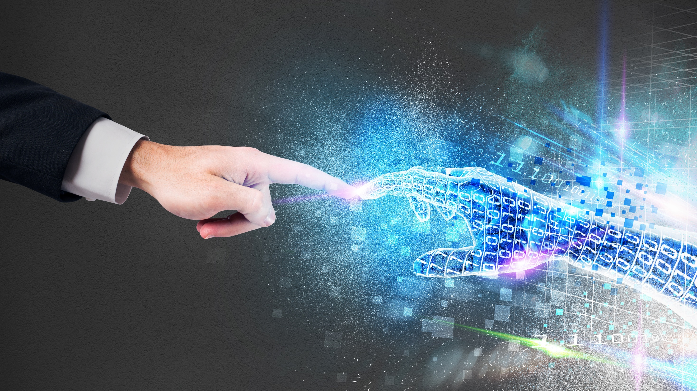

HUMAN AND MACHINE
AUGMENTATION NOT REPLACEMENT
AdobeStock Standard License
Notes:
(30 secs)
This is about tech working with us
This is about creating richer experiences
About us having great relationship with technology
About using the tech to augment our lives to enable us to achieve more

Slide 4



CORTANA INTELLIGENCE SUITE
Information Management
Big Data Stores
Machine Learning and Analytics
Intelligence
Business apps
People
Data Factory
Data Lake Store
Machine Learning
Cognitive Services
Data Catalog
SQL Data
Warehouse
Data Lake Analytics
Bot Framework
Custom apps
HDInsight
(Hadoop and Spark)
Apps
Event Hubs
Cortana
Stream Analytics
Sensors and devices
Dashboards & Visualizations
Automated systems
Power BI
Data
Intelligence
Action
Notes:
Natural and proactive interaction: Interact with your data and using natural language and speech through Cortana
Intelligent agents: Build intelligent agents or Bots that allow your users to interact with your intelligent solutions in more contextual and natural ways, including in your communications and social platforms—text/sms, Facebook, WhatsApp, WeChat, Slack, Skype, and more
Cognitive APIs: Add vision, speech, text, recommendations and face and emotion detection to your application to gain valuable insights for your business

Slide 5

MICROSOFT COGNITIVE SERVICES
25 API’s, 66 FUNCTIONS
Vision
Speech
Language
Knowledge
Search
Computer Vision
Content Moderator
Emotion
Face
Video
Custom Recognition Intelligence Service
Speaker Recognition
Speech
Bing Spell Check
Language Understanding Intelligent Service
Linguistics Analysis
Text Analytics
Translator
Web Language Model
Academic Knowledge
Entity Linking Intelligence Service
Knowledge Exploration Service
Q&A Maker
Recommendations
Bing Autosuggest
Bing Image Search
Bing News Search
Bing Video Search
Bing Web Search
Notes:
(30)
Across many different functions:
Vision – emotion detection, facial recognition,
speech to text, text to speech, translation,
text analysis – understanding what has been written and the sentiment of that text.

Slide 6


Humans
CONVERSATIONS
AS A PLATFORM
INTELLIGENCE INFUSED
Bots in conversational canvas
Personal digital assistants
Notes:
And making all of these conversations and connection possible is artificial intelligence
Making sense of the vast amount of data and converting that into intelligence interactions that are happening in the most human and natural ways

Slide 7

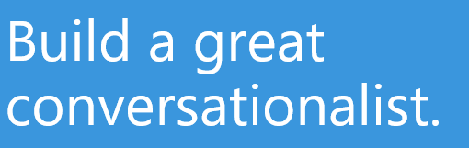
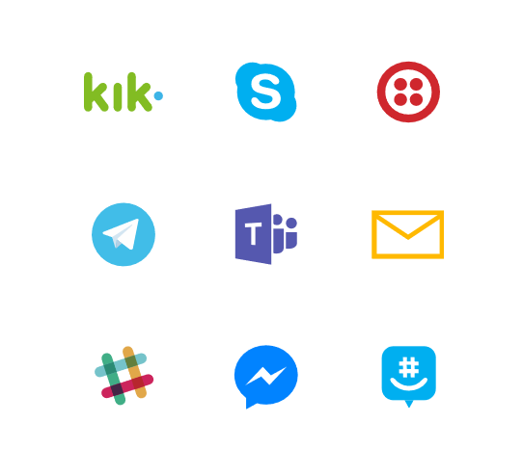
MICROSOFT BOT FRAMEWORK
Notes:
At Microsoft, we have the tools – a framework that enables everyone to create these conversational interfaces – to manage dialogs of conversation, to create fluid conversation between humans and machine using text and speech.
We utilise ML to undertake complex natural language processing, to detect sentiment in conversation, to auto translate and convert speech to text.

Slide 8
BOTS + COGNITIVE SERVICES
Computer vision API human readable captions
Computer vision API OCR for capturing information
Face API facial verification/authentication
Speech API voice verification/authentication
LUIS API understanding intent
Knowledge APIs retail product recommendation
Autosuggest API ease query input
Linguistic API sentiment analysis
QnA Maker conversational Interface for FAQs
Translation API Auto text translation & language detection
Translation API Auto speech (voice) translation
Bing Maps API User location
Notes:
More serious use cases for bots and cognitives:
Apps Powered Computer vision API- to create captions for the content of an image that has been uploaded to a bot
Like CaptionBot.ai
2. A bot to authenticate users using a voiceprint by leveraging the Speech APIs
Authentication as a user speaks to the bot with a speaker verification profile or “voiceprint”
Using the LUIS (Language Understanding Intelligent Service) API, a bot can recognize the intent of a user
LUIS analysis for queries such as “What is the weather in Toyko today?” using entities to parse out intent (what the user is asking for)
4. Knowledge APIs can give a bot the ability to recommend products frequently bought together based on our knowledge and/or a user’s history
Also, Knowledge could search through a graph database to return relevant academic papers from a natural language query
5. The Autosuggest API from Search can ease the burden of typing queries to a web search bot
Search also has other capabilities such as returning the latest trending news on a topic for example
by MS Cognitive Services

Slide 9





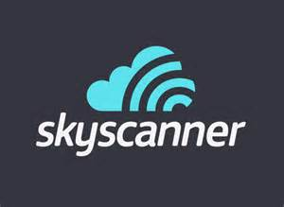










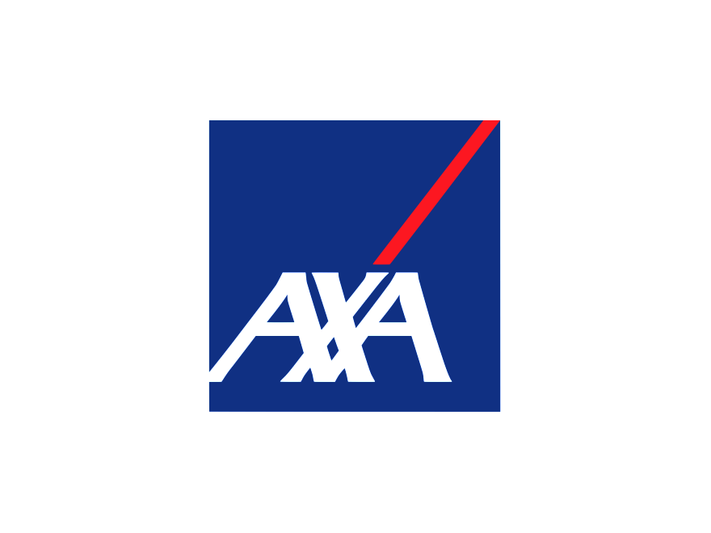




UK DX CUSTOMER HACKS
Notes:
This is what we are expecting to see at //BUILD:
Bot framework – voice, SfB, Cortana
Cortana – device, Cortana skills. Where?
Bots – productivity (internal scenarios), graph, Skype, Dynamics
Cognitive – CRIS, IRIS, translation, QnAMaker
Bigly short clip.

Slide 10
BOT ARCHITECTURE
Your code goes here
Web Chat
Bot Connector Service
Email
Message input <> output
State Management
Facebook
GroupMe
Your bot code
Bot Builder SDK
Kik
Skype
Bot Builder SDK
API, SDK calls
Slack
+ Microsoft Cognitive Services
Telegram
Other services, APIs,
Databases, Azure Machine Learning, Azure Search,
O365 APIs etc…
Natural Language
Translation
Vision/Face
Emotion
Twilio (SMS)
…
Direct Line…
Speech
Entity Extraction
Search
Knowledge API
…
…
…

